Slide 1
Lost and slipped muscle
Fusion 2012 LVPEI Hyderabad
Lionel Kowal
Melbourne

Slide 2
Slipped muscle : MR
2.5 y. ET since age 12m. CR +2.
ET cc 30 [sc 35], ET’ cc 35
BMR 5mm
Seen 4-5h after surgery
PERFECT alignment – demonstrate symmetry of corneal light reflections to parents
‘see me 7-10 days…email me a photo if you have any concerns’

Slide 3
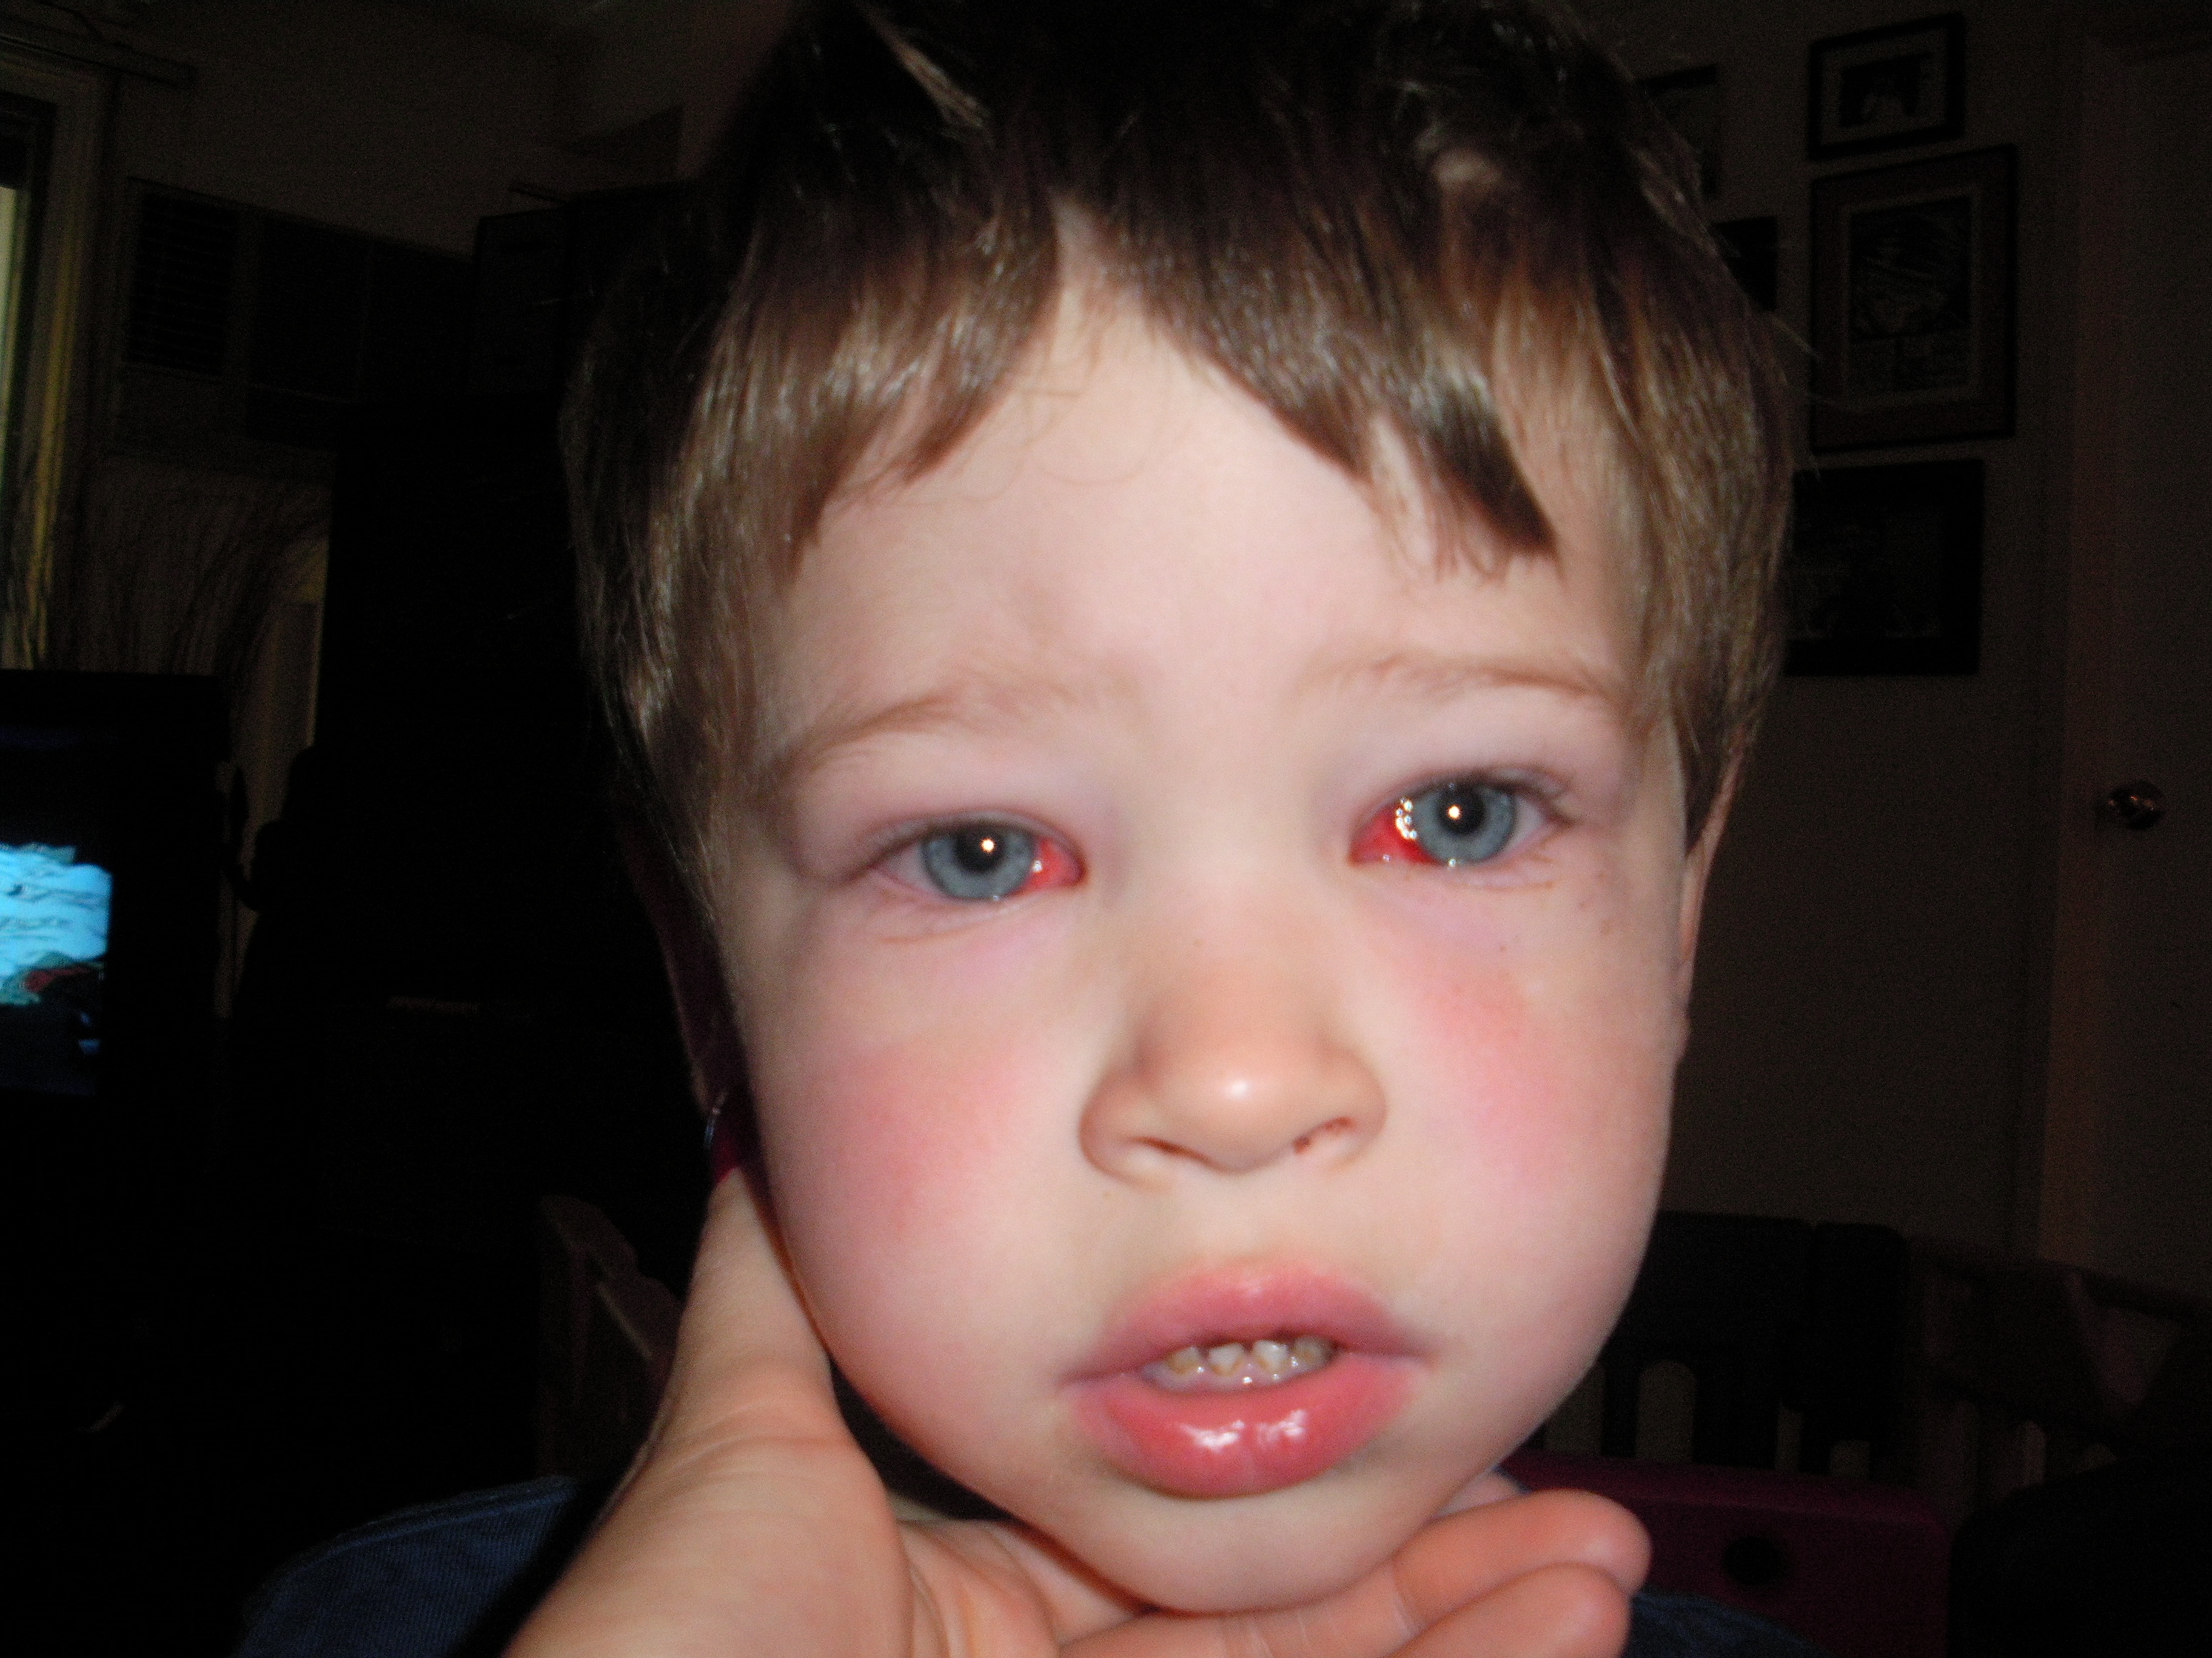
Day 2
XT 16, XT’30.
No MR UA
I am really concerned about the vision he is seeing.
He is trying to grasp at things that are a couple of centimetres away from where he thinks things are. Attaching trailers to trucks and cars are very hard as he is getting very upset with confusion and frustration as to why they are not attaching together.

Slide 4
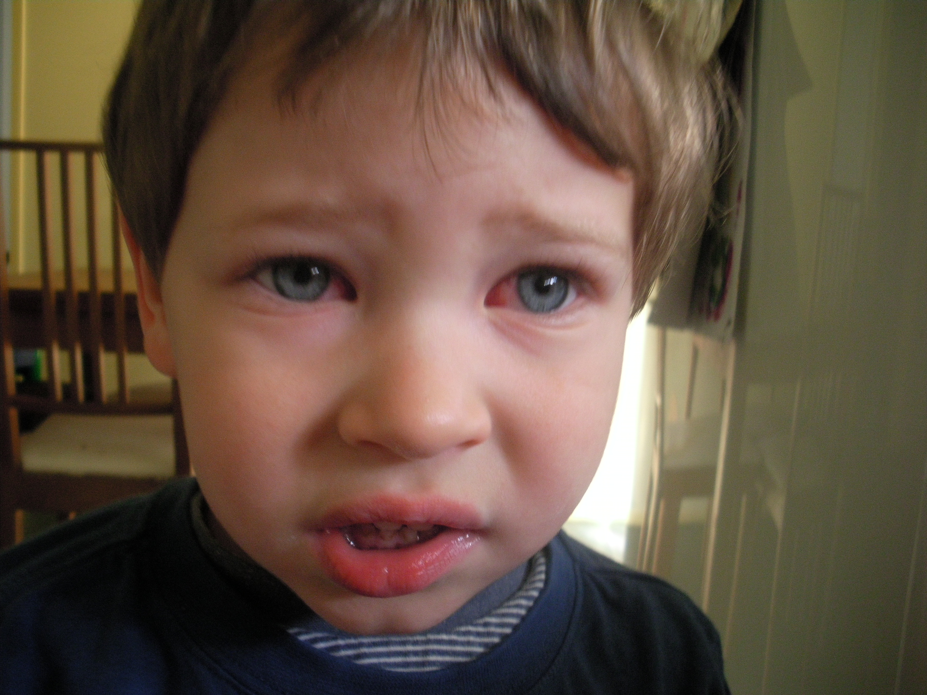
Day 4
XT 14, XT’25
No MR UA
I feel that the left eye is turning even more to the outer side.

Slide 5
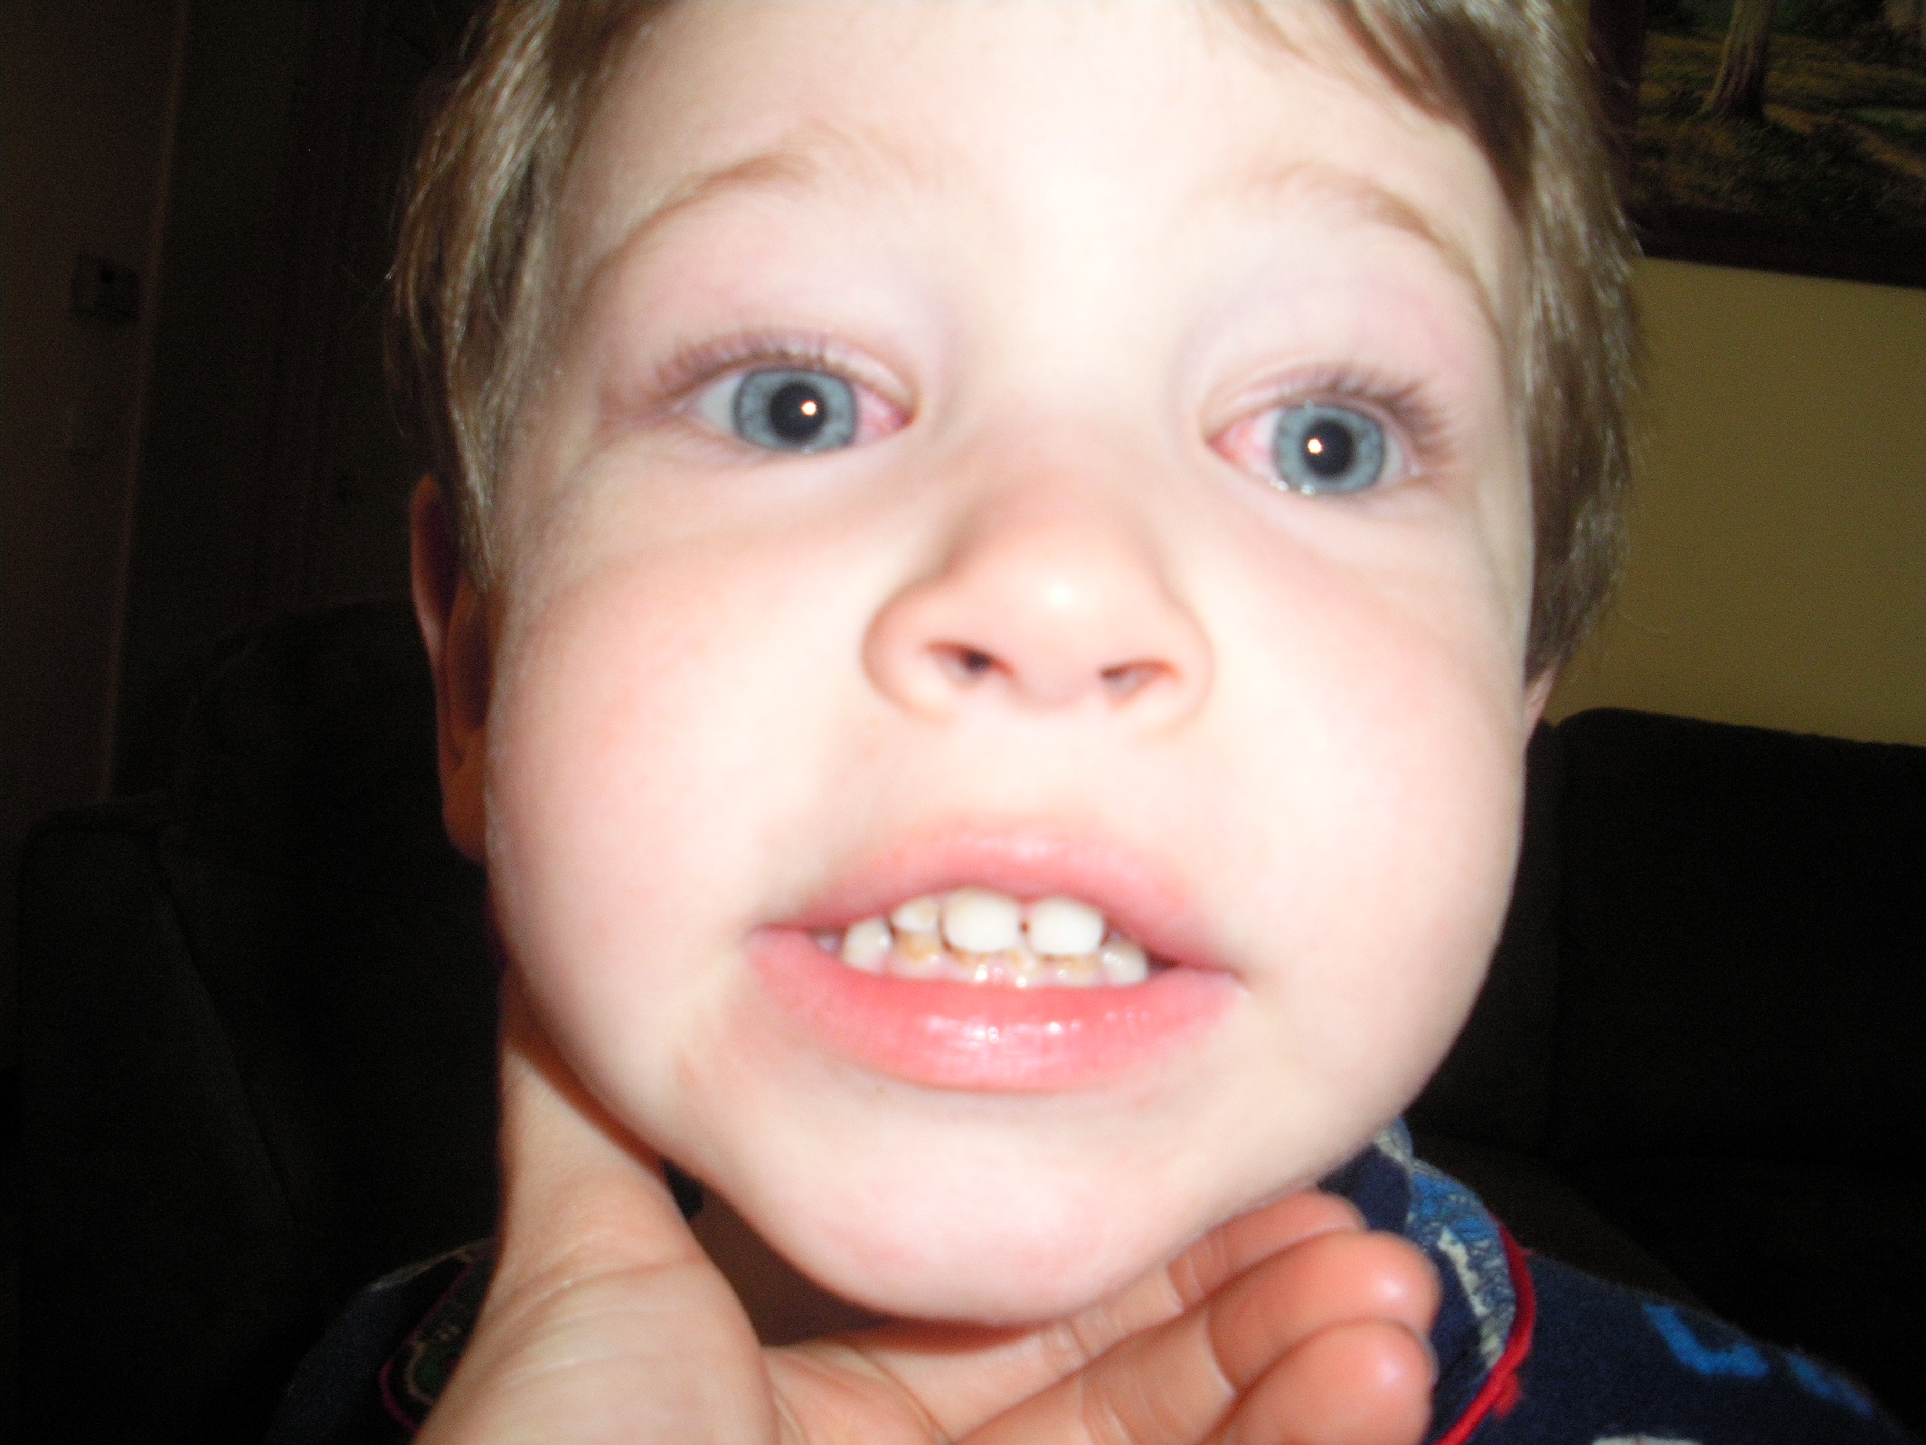
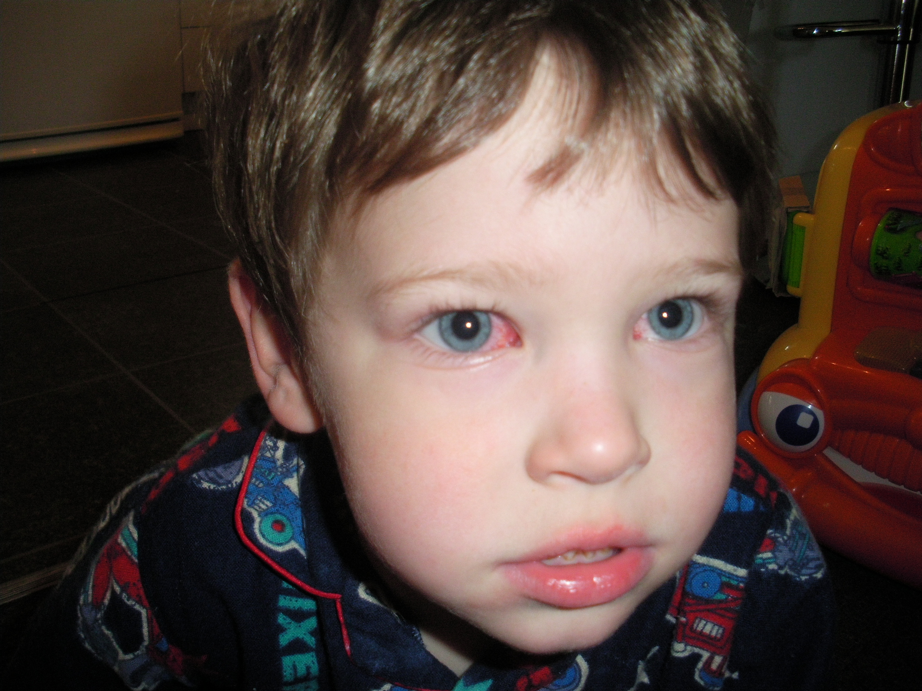
Day 5 - no change
Day 9: XT 14, XT’ 20 No MR UA

Slide 6
Day 10 : consecutive XT – not getting better
FINDINGS:
Springback R&L XT 2+ [R>L]
SURGERY:
RMR 8mm from insertion [hangback knot undone], L 5.5
RMR resutured [~1mm resect] and advanced to 5mm from insertion. Springback R now ~0.
7 mo post op 3y3m
sc straight D&N
Fuses 4 dot. No Fly

Slide 7
? Slipped muscle
Need to monitor closely
On day 1 can be difficult to sort out – muscle spasm / hemorrhage / pain on movement /…
If it doesn’t get better quickly, don’t wait – it doesn’t get better
COSSARI’S DELAYED ‘ADJUSTMENT’
Doesn’t do day 1-2 adjustables
Tells all pts that if the result is not good on day 6 there will be a 2nd surgery on day 7

Slide 8
Slipped muscle: SR
KE, 65yo
40 yrs ago: closed head injury. No LOC.
6 years ago [elsewhere] 16^ LH. LIO myectomy [no precise details]. 3 w post op 8^ LH. Patient recalls no improvement to diplopia or head tilt.
Now complains of vertical diplopia and head tilt [giving neck pain]
MRI: atrophic LSO
Up right LH 8Δ | Up X6Δ | Up left LH 10Δ
Right LH16Δ | PrimaryLH 16Δ | Left LH 16Δ
Down right LH20+Δ | Down 0 | Down left LH 14Δ
L tilt LH 30 | R tilt LH 4Δ
Head tilt R 15 ° | 15Δ BD LE small range single vision | LIO+, LSO-, LIR-

Slide 9
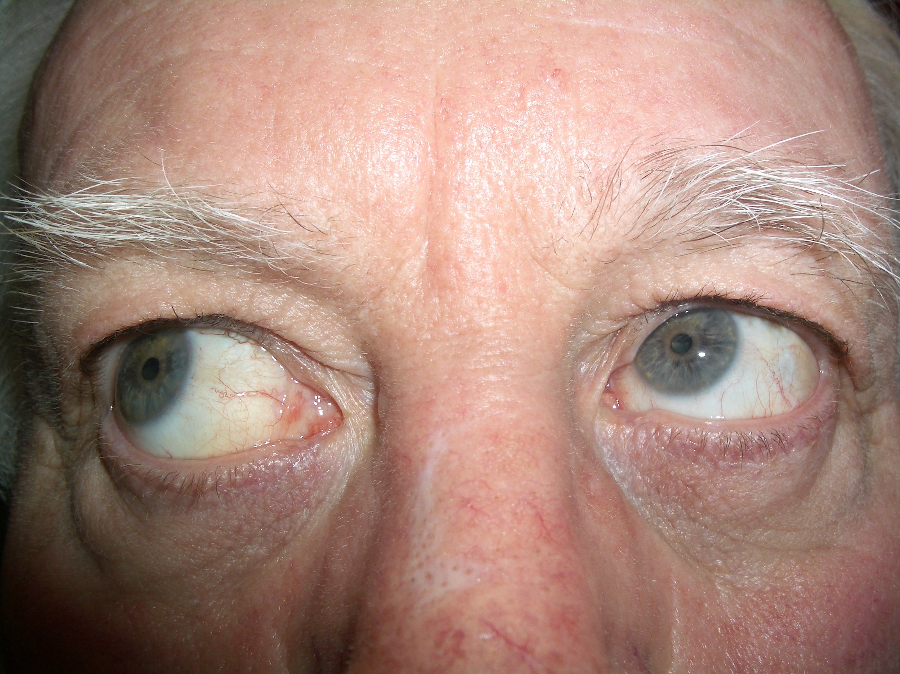
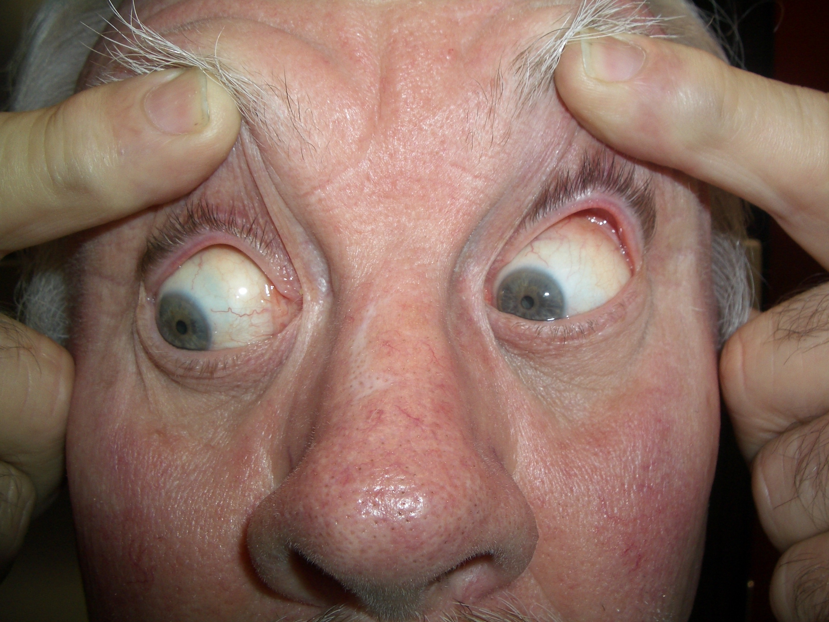
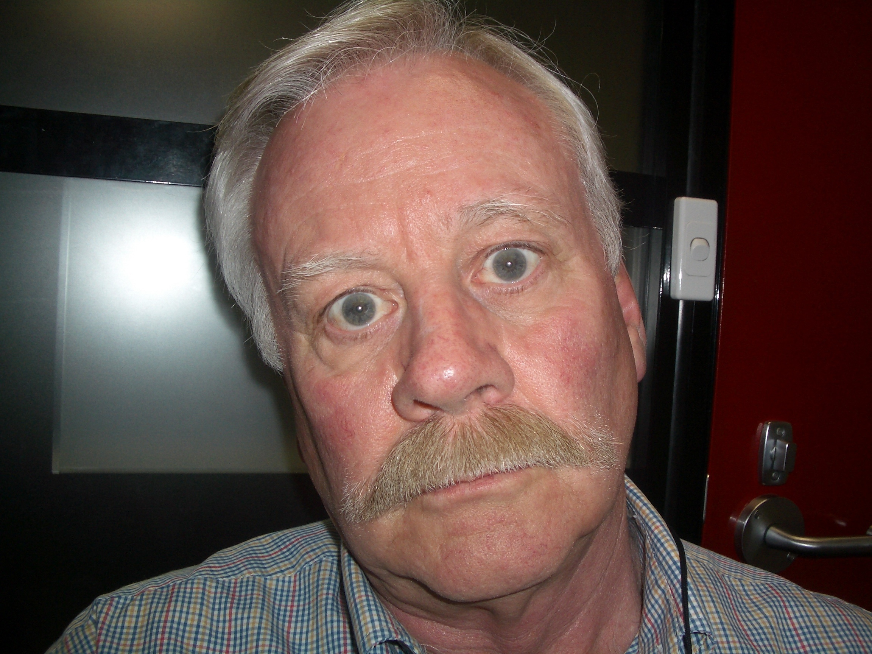
Operation notes [July 22]:
Findings: LSO not floppy. LSR tight
Surgery:
LSR recess 3mm, transposed temporally to edge of insertion, adjustable, 6/0 vicryl
RIR recess 3mm, fixed, 6/0 Mersilene
S/conj dexamethasone.
Adjustment:
LH 8-10Δ. LSR re-recessed X2

Slide 10
Week 1-8
Day 6 post op
Large range single vision
Fuses 4 dot
Vertical fusion range in primary: BD R3Δ, BD L2Δ. Horizontal +/- 4
Week 5 postop:
100” Titmus
Vertical fusion range in primary: +/-3. Horizontal – 4 to +10
Large range single vision
Sometime between weeks 5 & 8 things go awry.
Now has diplopia on L gaze.
RH 5Δ | LH2Δ | LH6Δ

Slide 11
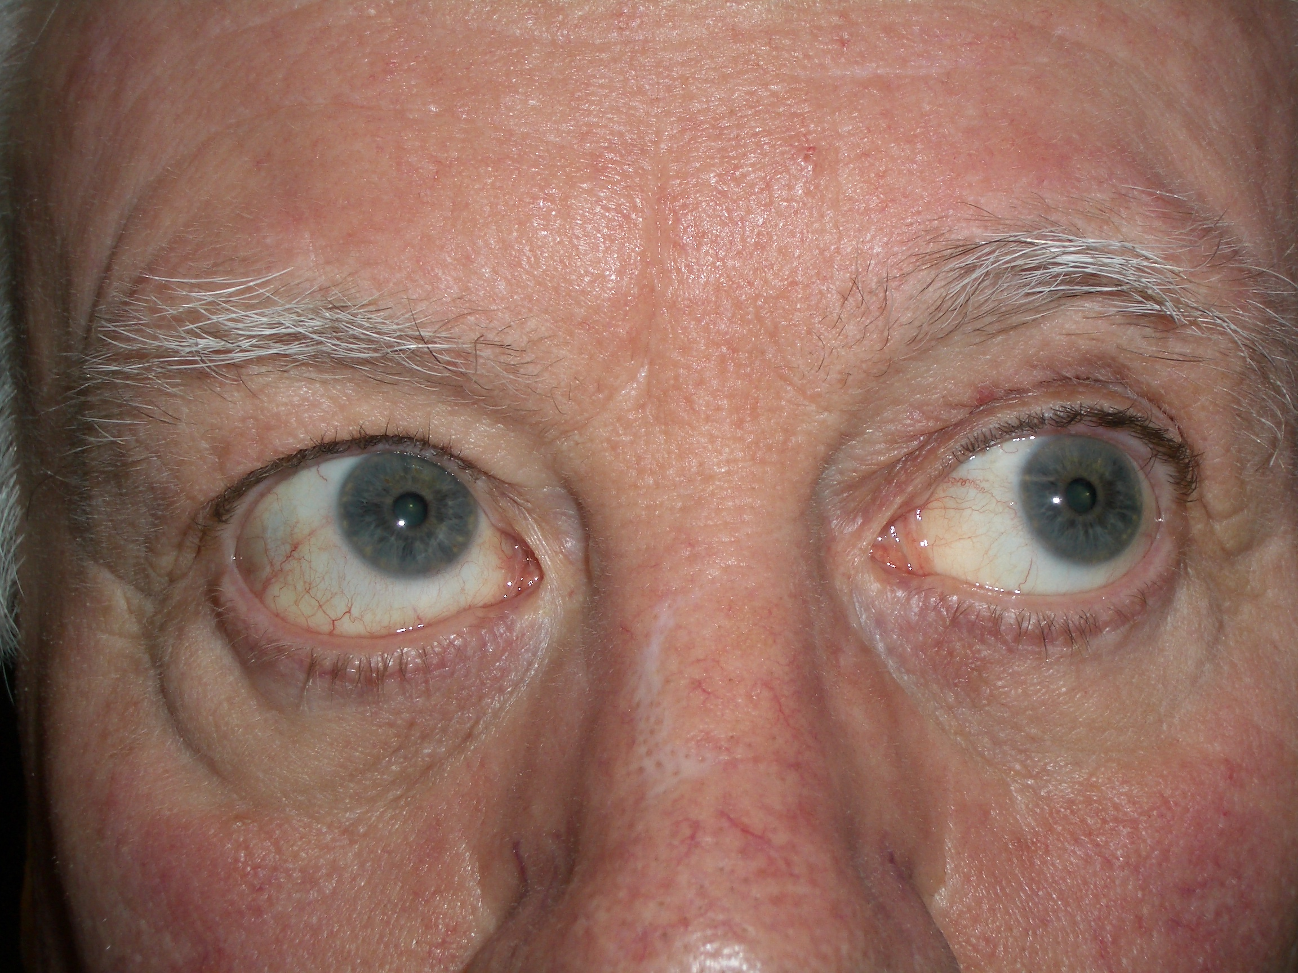
LSR slippage
Up right 0 |  | Up left RH 16 2w later: 20
Right 0 | Primary RH 8 2w later : 14 | Left RH 20 2w later: 25
Down right LH 1 |  | Down left RH 14
LIO+, LSO-, RIO+ | 7Δ BDRE small range single vision | Titmus 400”

Slide 12
LSR slippage
FINDINGS:
LSR 7.5 mm from original insertion
LSO caught up in insertion
SURGERY:
LSO bluntly dissected away from LSR insertion
LSR advanced to ~3mm recess [after springback test @ end of surgery], 5/0 Vicryl, adjustable
LIR recess 0mm, 6/0 mersilene adjustable and 5/0 vicryl ‘braces’
S/c dexa. Topical Betadine, Voltaren
Adjustment:
Looked fine – good range single to L, to R, 15-20 deg up & down.
LIR Mersilene and vicryl tied off

Slide 13
Superior rectus slippage
It is important to separate the SR / SO connection (frenulum) when you do SR Rc and especially when you transpose.
Otherwise, the SO drags with the SR and can lead to possible non-adherence on a hang back.
The other possibility is that when I adjusted x2, it did not take up the slack fully, and then later it did.

Slide 14
Mark Greenwald
I always use a non-absorbable suture (usually 6-0 Mersilene) when doing superior rectus hang-back, my preferred technique for large (>6 mm) SR recessions. ….There is a persistent bump at the knot site, but it's well behind the upper lid and has never caused a problem in my experience
also Irene Ludwig
LK: increasingly using non-absorbable for SR

Slide 15
Slipped muscle : IR
Natalie C. Kerr, Tennessee
Role of Thyroid Eye Disease and Other Factors in the Overcorrection of Hypotropia Following Unilateral Adjustable Suture Recession of the Inferior Rectus
Trans Am Ophthalmol Soc. 2011 December

Slide 16
Progressive over correction after IR recession POCIR
TED: POCIR common with absorbable suture, uncommon with non-absorbable

Slide 17
Progressive over correction after IR recession POCIR – non-thyroid
Variable rates POCIR with absorbable sutures
Kerr 0%
Springer 10%
Non- absorbable sutures: near 0% in all

Slide 18
Inadvertent transection of inf rectus
25 cases of lost muscle
21/25 during strabismus surgery
6/21: inadvertent IR or SR transection when operating on inf or sup obl
Plager DA, Parks MM.
Recognition and repair of the slipped rectus muscle.
J Pediatr Ophthalmol Strabismus 1988;25:270-4

Slide 19
Persisting post op hypertropia
6 y o boy
Referred for a 2nd opinion 3w post Sx with RH.
“V” pattern LET since 2 y o.
Glasses: +2.50 OU (cyclo +5.00) and had patch to R.
Had BMR (5 to 11mm from the limbus) + bil IO myectomy
D1: RH with depression deficit greater on aBduction.
3w: sl improvement of R depression, RIO OA.

Slide 20
On Examination:
RVA 6/12cc LVA 6/9cc
sl under plused
C-T : D RH 25 LET 16
N RH’ 30 LET’ 14
Up Gaze F extorted
Down Gaze F intorted

Slide 21
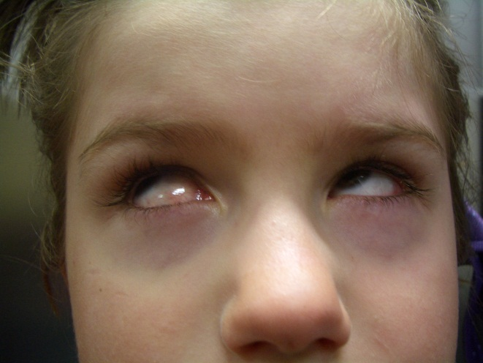
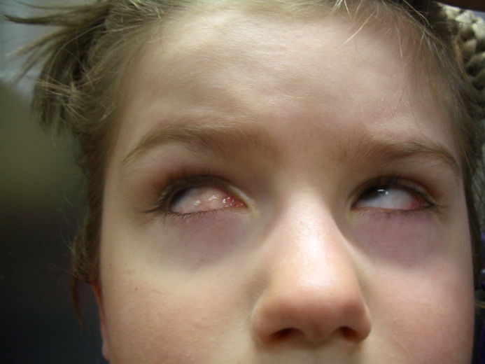
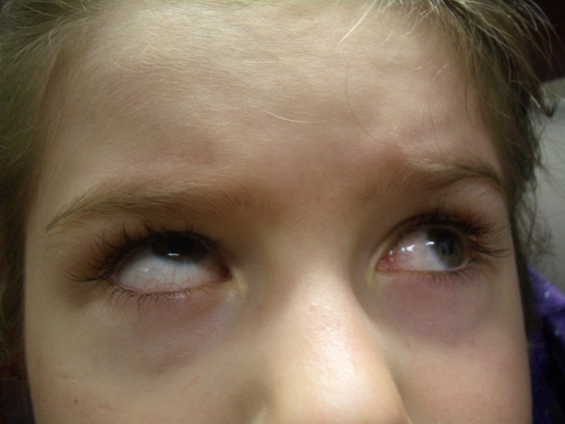
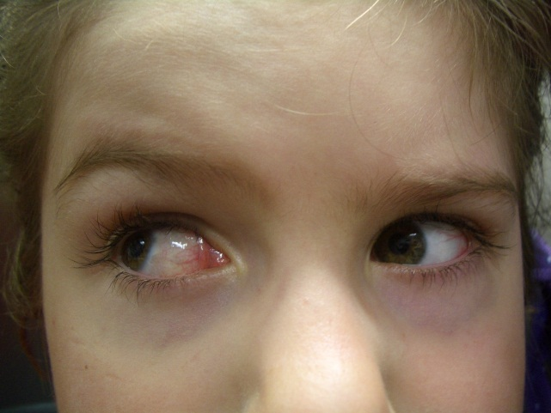
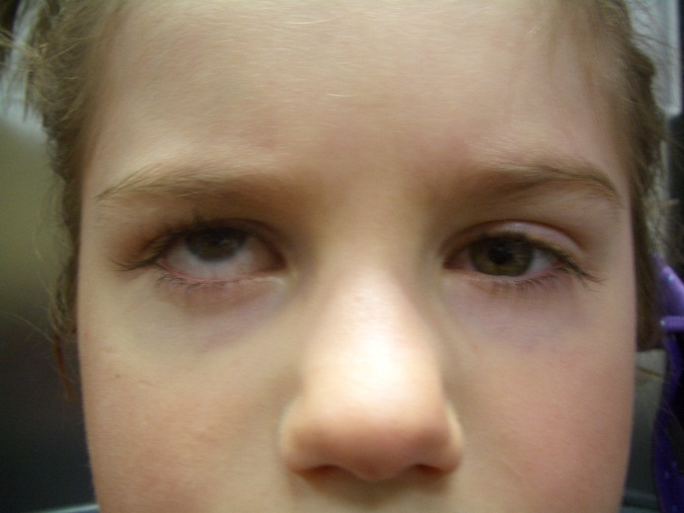
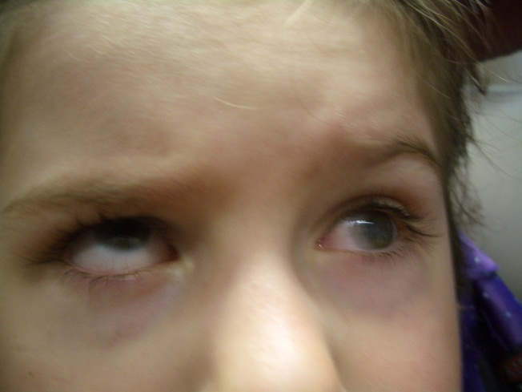
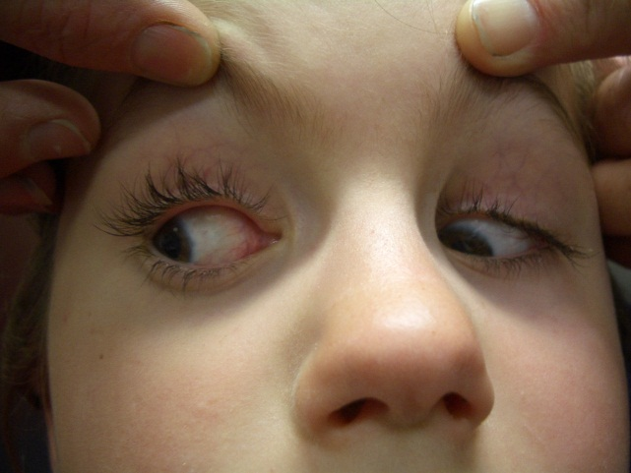
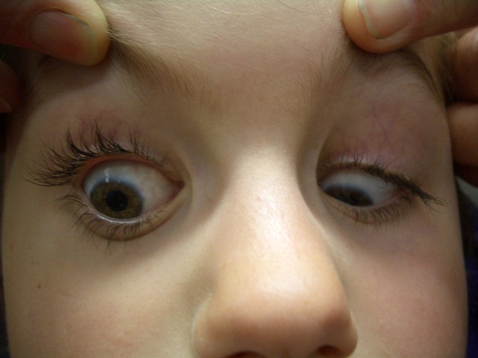
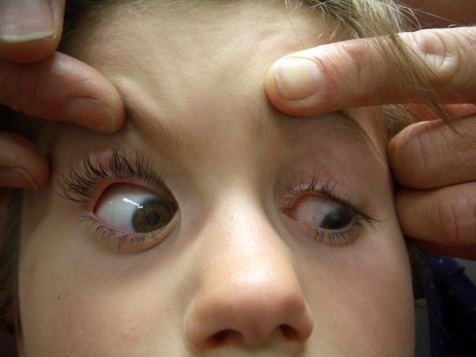
RIO OA +5
RHT in PP
RIR UA -4

Slide 22
Surgical findings
3w post 1st Sx
Findings: RIO found to be normal
RIR had been disinserted and was not found.

Slide 23
Procedure:
RIO sutured just ant to lat edge RIR insertion.
The lower ½ of the R MR+LR sutured to the nasal and temporal edges of the RIR insertion.
L LR resected

Slide 24
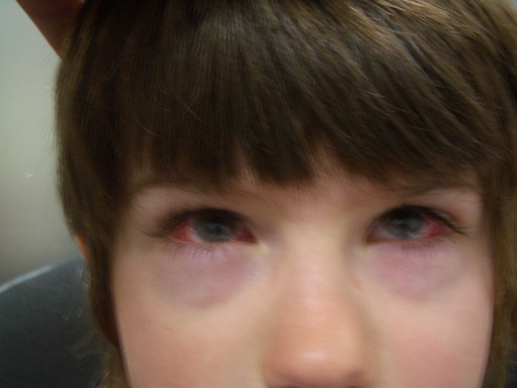
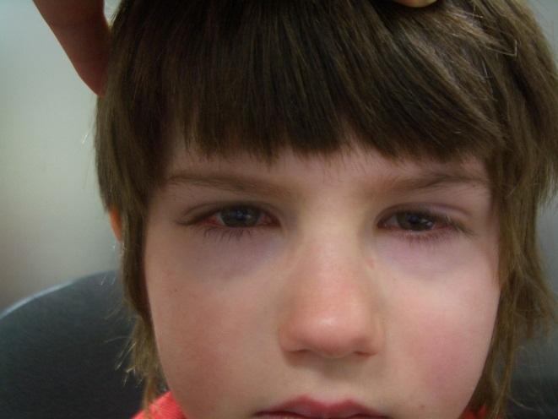
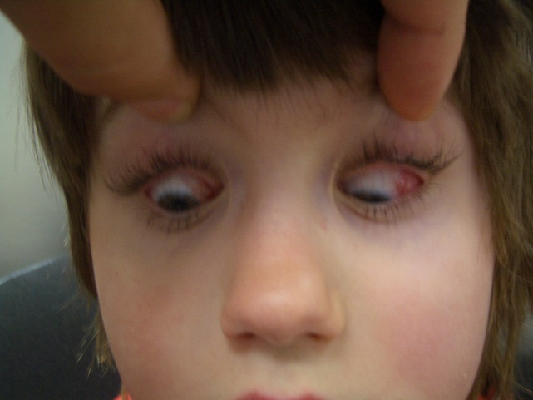
3m post op:
Infrequent diplopia
Straight for D&N
Some sensory fusion
DG: sl restriction (R),
sl ET on DG.
UG barely restricted

Slide 25
Discussion: surgical results (1)
3 pts with snapped IR (between the muscle and its tendon, 8-10mm behind the insertion) during squint Sx.
Treated: a modified inverse Knapp procedure - transposition of the inf halves of the horizontal recti to the insertion of the IR.
1 pt was ortho, 1-needed Δ and 1- reoperated.
1 had good infraduction, 2 limited.
The snapped inferior rectus. Kowal et al, Aust N Z J Ophth 1998

Slide 26
Discussion: surgical results (2)
2 pts with ruptured IRM were Treated with modified Jensen transposition procedure : inferior transposition of the inf halves of the horizontal recti w/o disinsertion.
Results: small overcorrection treated with prisms and reop. Both had SV in PP and 40º of depression.
Surgical management of strabismus after rupture of the inferior rectus muscle. Paysse EA et al. JAAPOS 2000

Slide 27
Discussion: surgical results (3)
A snapped IRM during endoscopic ethmoidectomy procedure, was treated with IOM transposition with restoration of fusion in PP.
Anterior transposition of the inferior oblique muscle for a snapped inferior rectus muscle following functional endoscopic sinus surgery.
Aquirre-Aquino et al.
Ophth Surg laser imaging 2005

Slide 28
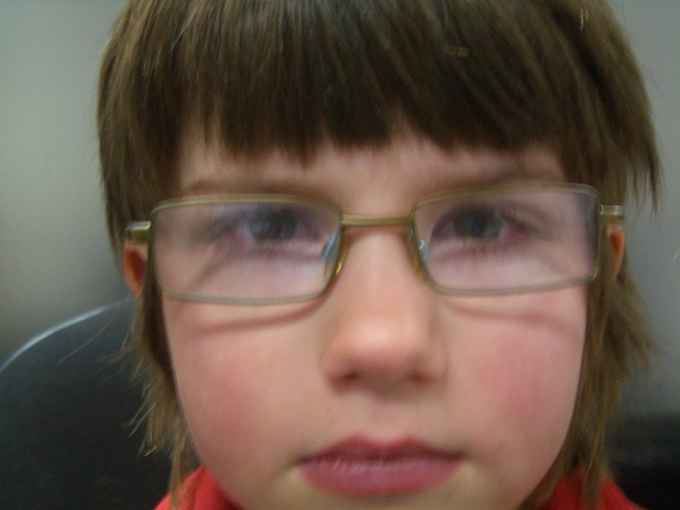
In summary
Occasional squint surgeons: inferior oblique surgery is challenging.
If result is weird, refer / re-operate quickly.
The result might have been even better if IR was found.

Slide 29
What suture to use in high risk cases e.g. inf rectus recession?
Mersilene – non absorbable
S29 needle is small
S14 needle is more robust [and ⬇$]
BUT
It irritates +++ in some patients
Is better kept well behind the insertion
Can cause persistent conj redness
Therefore cannot be used as an adjustable

Slide 30
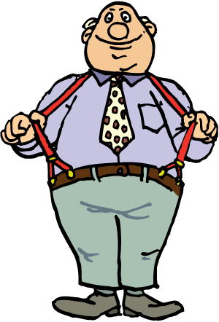
6/0 Mersilene [adj] - 5/0 Vicryl belt and braces
Use Mersilene as adjustable
Use 5/0 vicryl as ‘back up’ alongside the Mersilene
If Mersilene irritates ++ I feel less anxious about trimming or even removing the knot because the Vicryl is / was there

Slide 31
Is UBM helpful?

Slide 32
UBM helpful? My first 2 cases…
Muscle | Predicted insertion mm from limbus | Actual insertion mm from limbus
LLR | 8 | 9
LMR | 6.7 | 12
RMR | 8.7 | 10, and a pseudotendon of 10mm
RLR | 6.5 | 13
Beautiful pictures – a pity they were not accurate and helpful

Slide 33
RADIOLOGY
Some authors
find radiology
diagnostically useful

Slide 34
Radiology 2
Many authors do NOT find radiology helpful

Slide 35
Slipped muscle or stretched scar?
The difference is not B&W

Slide 36
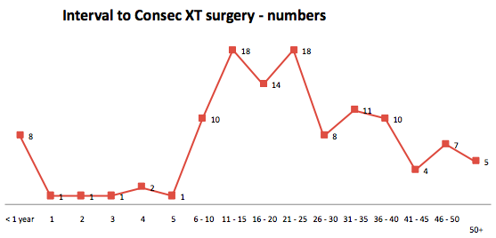
Interval to surgery for consecutive XT
Kowal, Bender,…
This early group
probably contains
slipped muscle
It is not credible that
this late group contains
many ‘slipped muscles’
MEDIAN TIME TO SURGERY 22 YRS. AVERAGE 23.

Slide 37
Lost / broken [PITS] muscle
Usually not a diagnostic problem
Explore quickly, with assistance
Sometimes radiology CAN help diagnosis
Sometimes an orbital surgeon can help you

Slide 39
Goldberg, Amer J Ophth, July 2001

Slide 40
When to transpose

Slide 41
When not to transpose : Myopathy
..CPEO, burnt out Myasthenia
If the muscle is so weak as to easily fall apart, it may not be having much effect
CASE: CPEO, XT
Planned LR Rc, MR Rs: ‘PITS’ MR
MR not recoverable
XT improved next morning after LR Rc

Slide 42
How to transpose : for horizontal recti
ASI a risk:
60% transposition [measure – be symmetric]
MR: resect 5mm, LR resect 5mm
ASI not a risk:
Resect whole muscles
Foster transposition

Slide 43
How to transpose : for vertical recti
Whole muscle transposition with Foster augmentation sutures
Exceptions:
Simultaneous horizontal ET/ XT surgery: split muscles and do ET/XT surgery on non-transposed halves
Inf rectus: if split muscles, ATIO to edge IR insertion as well

Slide 44

Thank You
Yarra River footbridge Melbourne Australia

Slide 45
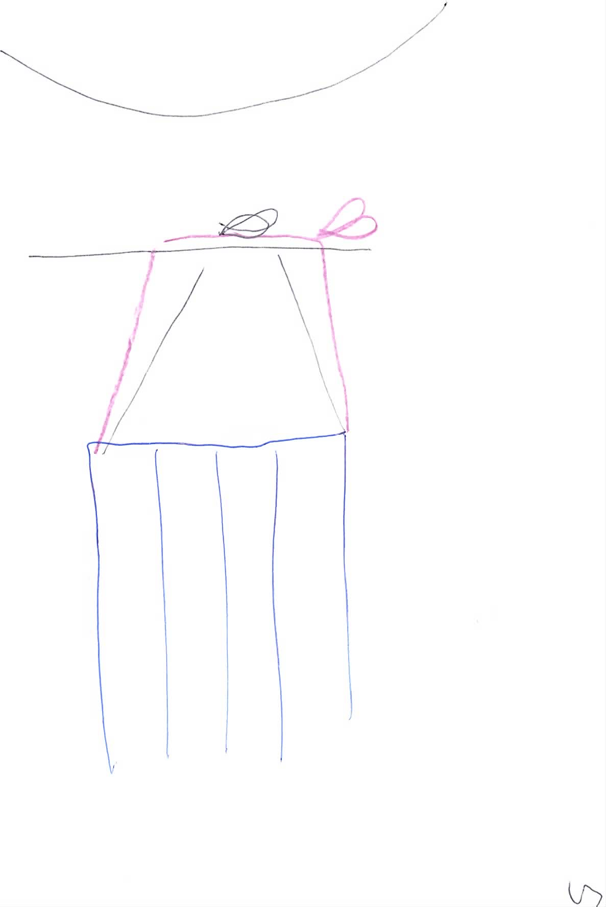
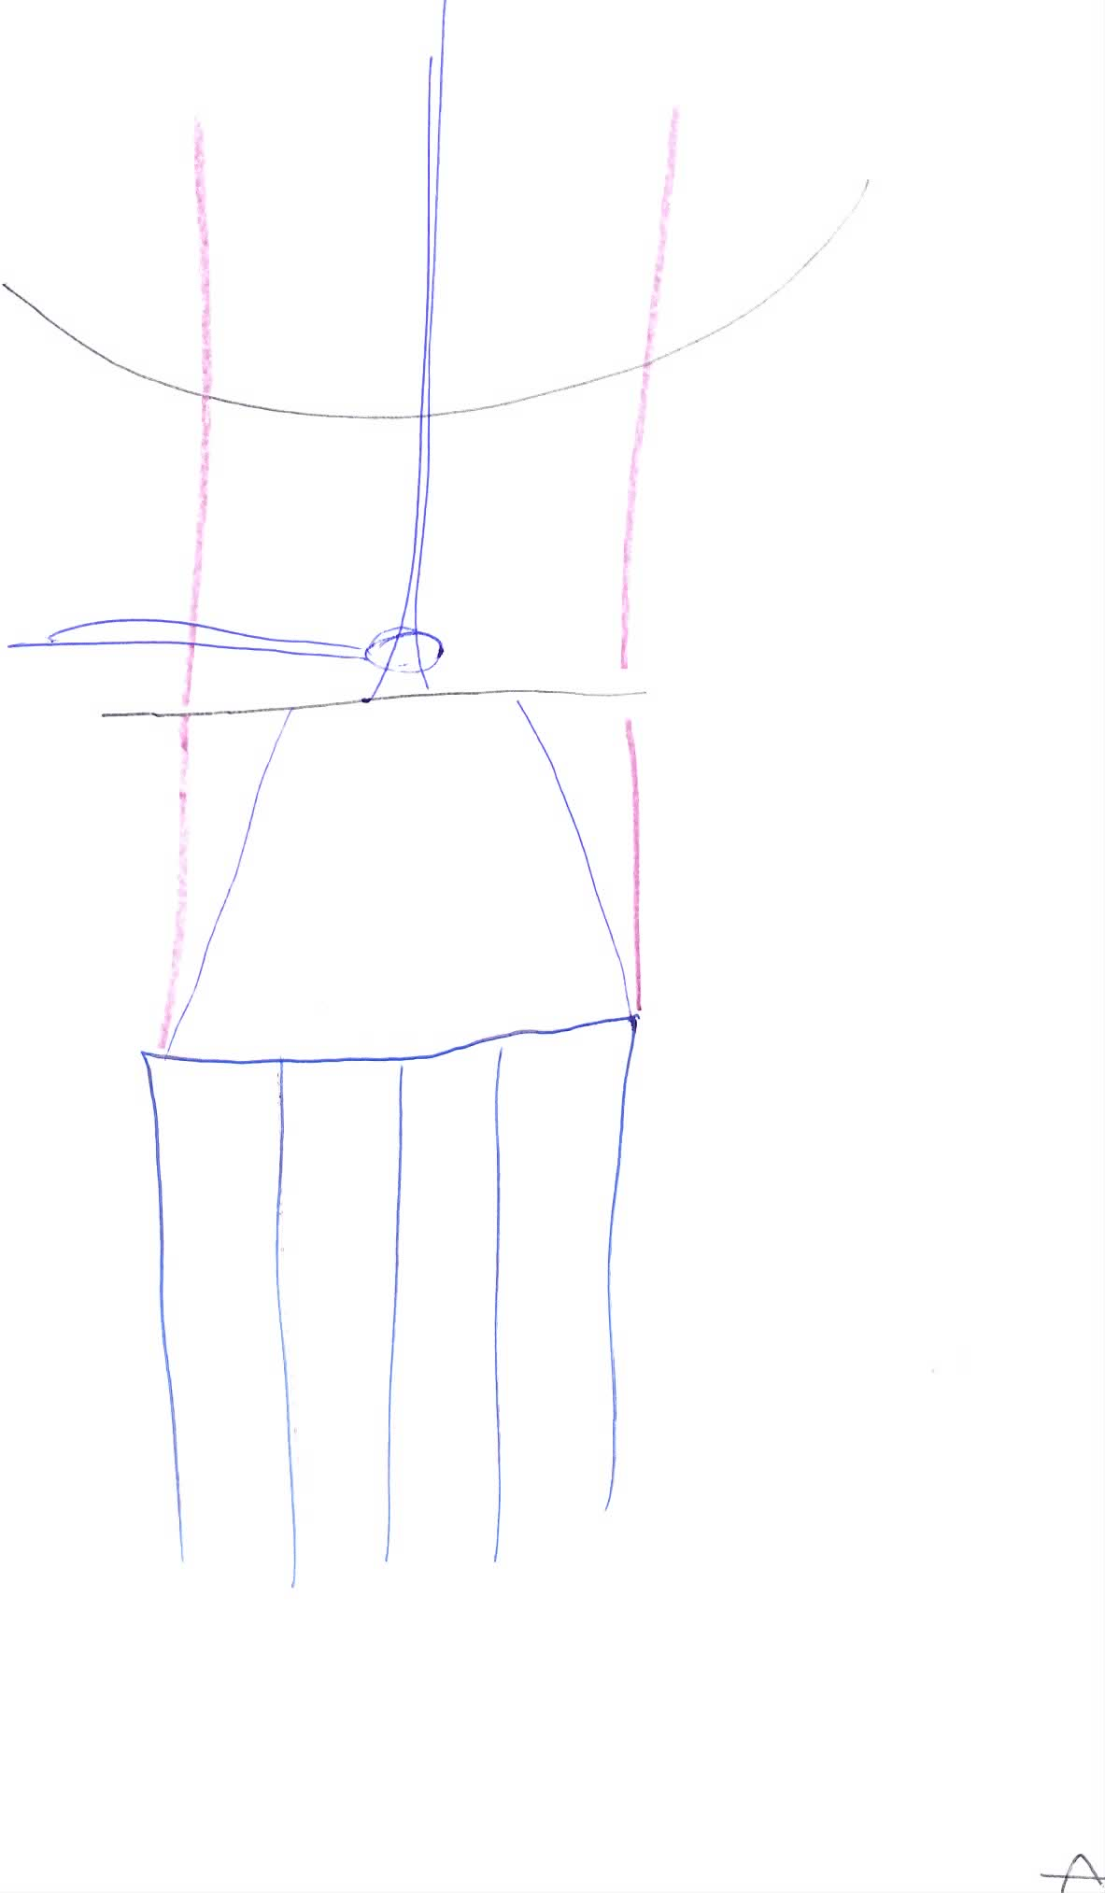
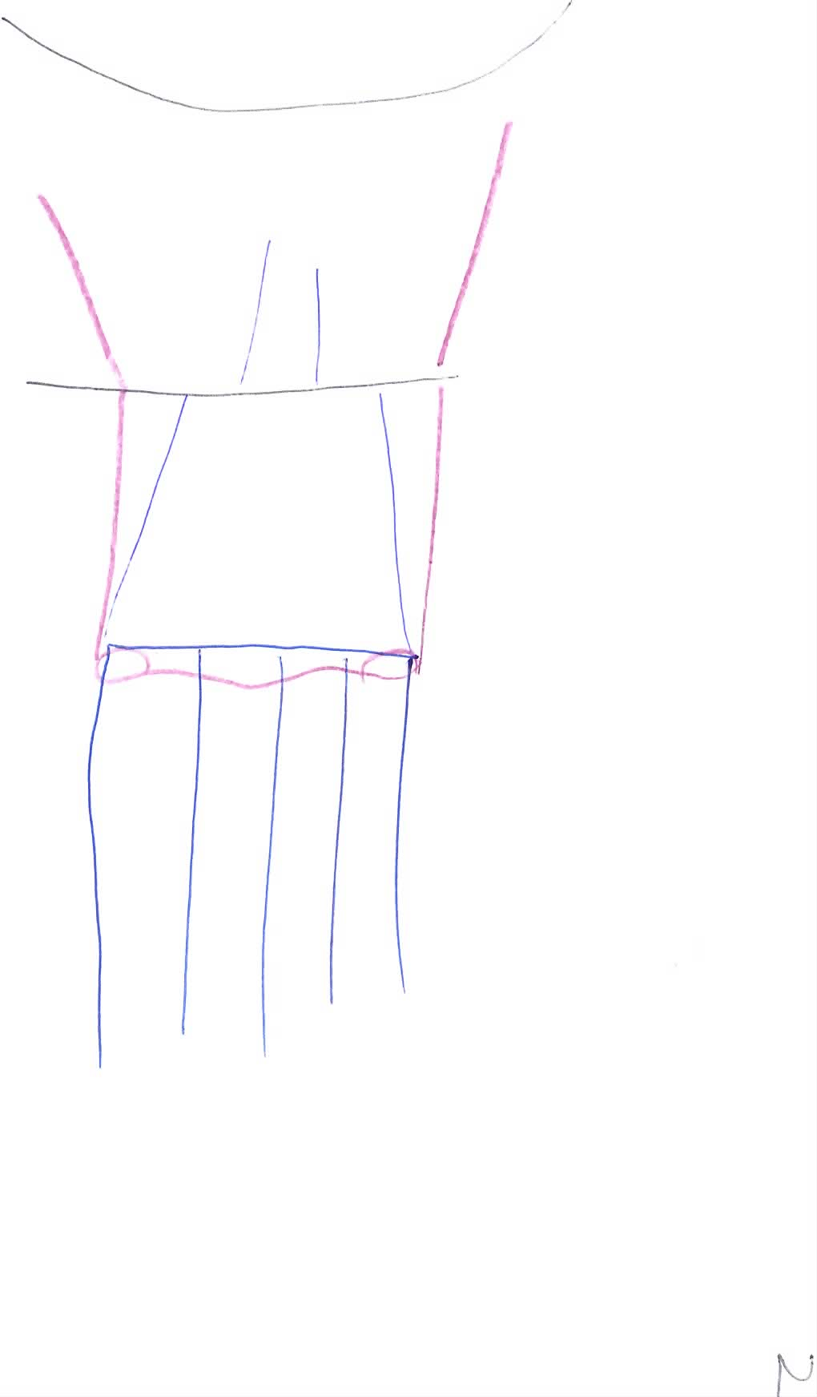
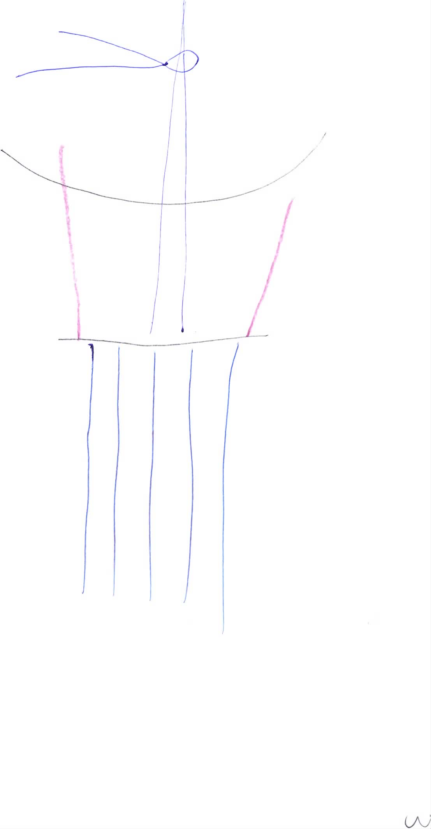
6/0 Mersilene - 5/0 Vicryl belt and braces
Mersilene
adjustable
limbus
Mersilene
adjustable
After
adjustment
Vicryl
‘braces’
through
insertion
Before
adjustment
Muscle
pulled
forward
Muscle

